Slide 1


CSE 470 - Software Architecture
BRAC University

Slide 2
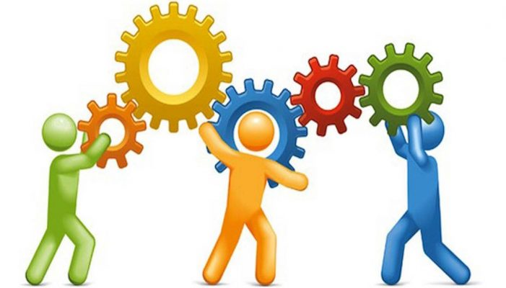
Software Architecture
Architectural design is concerned with understanding how a software system should be organized and designing the overall structure of that system.
Software Architecture is how the defining components of a software system are organized and assembled. How they communicate each other. And how the constraints of the whole system is ruled by.
The architectural model serves as a input to the development phase.

Slide 3
Architectural Representation
Simple, informal block diagrams showing entities and relationships are the most frequently used method for documenting software architectures.

Slide 4
Advantages of explicit architecture
Stakeholder communication
Architecture may be used as a focus of discussion by system stakeholders.
System analysis
Means that analysis of whether the system can meet its non-functional requirements is possible.
Large-scale reuse
The architecture may be reusable across a range of systems

Slide 5
Architecture Design Decisions

Slide 6
Architectural View
There are four views from which the architecture of a software can be observed
Each architectural diagram only shows one view or perspective of the system.

Slide 7
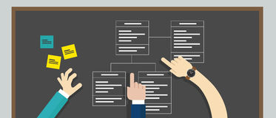
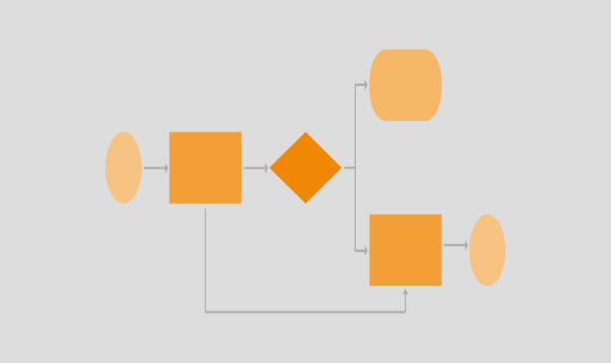
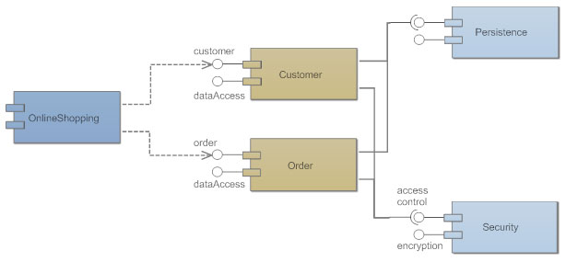
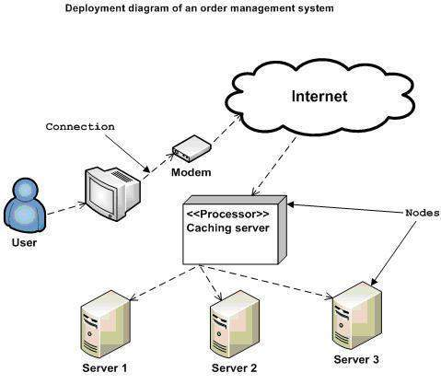
4 + 1 view model of software architecture
A logical view, which shows the key abstractions in the system as objects or object classes. (class/state diagrams)
A process view, which shows how, at run-time, the system is composed of interacting processes. (activity diagram)
A development view, which shows how the software is decomposed for development. (Component/package diagram)
A physical view, which shows the system hardware and how software components are distributed across the processors in the system. (Deployment diagram.)
Related using use cases or scenarios (+1)

Slide 8


Architectural Pattern
Lets think of some problems -

Slide 9
Architectural Pattern
An architectural pattern is a stylized description of good design practice, which has been tried and tested in different environments.
It’s a solution to a existing and commonly occurring problem.
Patterns include information about when they are and when they are not useful.

Slide 10
MVC Pattern
MVC goes for Model-View-Controller Pattern
Separates presentation and interaction from the data handling logic.
The system is structured into three logical components that interact with each other- Model, View and Controller

Slide 11
Controller
Handles all the user inputs through url
The interaction to an application starts here by the user interactions – mouse click, key press etc
Process http url requests (GET, POST, PUT, DELETE)
GET: for getting a data
POST: for posting / inserting a data
PUT: for updating a data
DELETE: for removing a data
Communicates with both Model and View
Contains all server side logic
In the example – ProductController, UserController, AccountController etc.

Slide 12
Model
It refers to the Data Related Logic
Interaction with database (such as SELECT, INSERT, UPDATE, DELETE)
It communicates with the controllers
Can sometimes update or collaborate with the view (Depends on framework)
In the example – Product, User, Transaction, Cart etc are model classes.

Slide 13
View
What the end users see (UI)
Usually Consists of html/css
Communicates with the controller
While coding are passed as dynamic values from the controller
A controller can have multiple associated views.
In the example – product.html, user.html to view a html file

Slide 14

Model
View
[4] Get Presentation of the product data
[2] Get the product data from DB
[5] Returns the presentation with dynamic rendering
[3] Fetch the data and return to controller
[1] Request: Get a product
Controller
Routes
[6] Returns the response

Slide 15
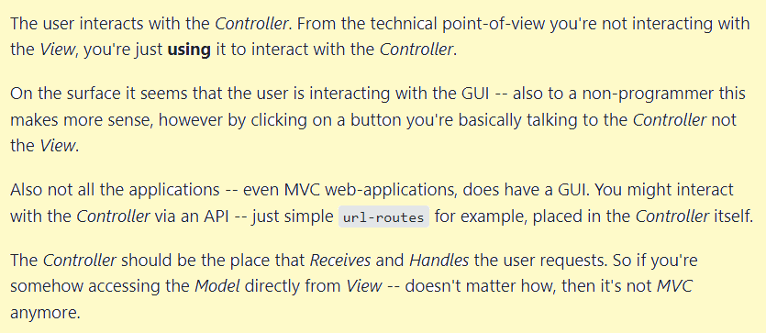
Some debate:

Slide 16
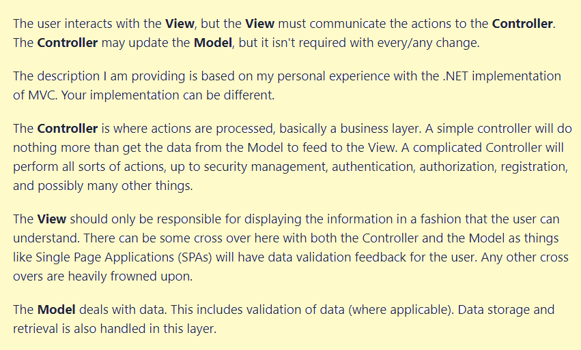
Some debate:

Slide 17
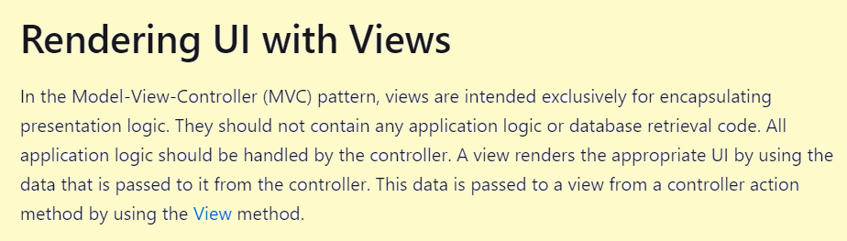
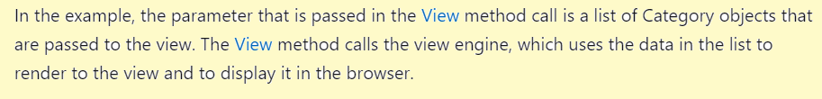
Some debate:

Slide 18
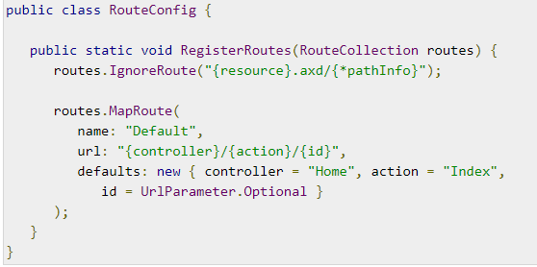
Routes
Are urls to access a resource
General structure - http://domainName/{controller}/{action}/{id}
http://YourApp.com/Users/Profile/25

Slide 19
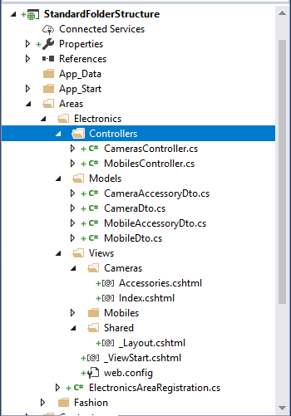

Slide 20
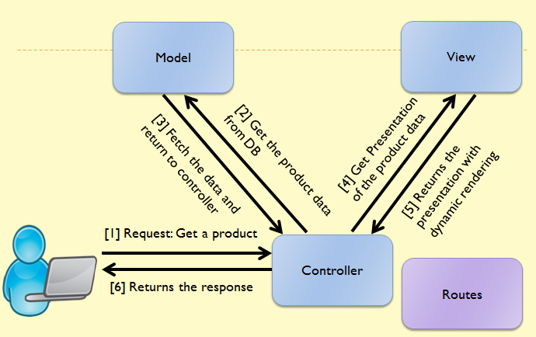
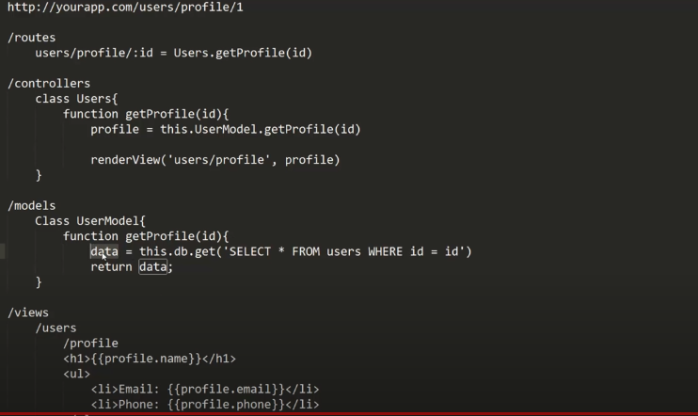

Slide 21
When Used:
Used when there are multiple ways to view and interact with data. Also used when the future requirements for interaction and presentation of data are unknown.
Advantages:
Allows the data to change independently of its representation and vice versa. Supports presentation of the same data in different ways with changes made in one representation shown in all of them.
Disadvantages:
Can involve additional code and code complexity when the data model and interactions are simple.

Slide 22
Summary
MVC is one of the most used architectural patterns.
It divides the system into three parts – model, view and controller
It provides a extensible separation of concern (SOC) from presentation view to data processing logic.

